Slide 1

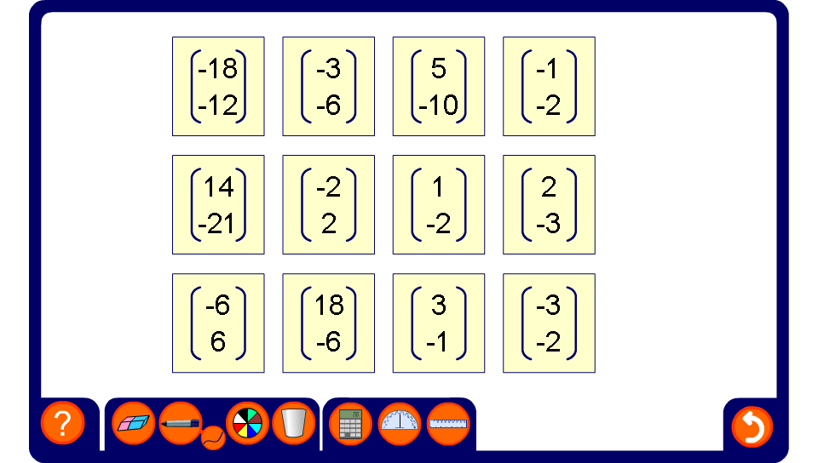


Pairs – parallel vectors
Notes:
In this activity pupils have to match pairs of vectors that are parallel. Discuss how this can be done by dividing the horizontal and vertical component in each vector by the highest common factor. This could be compared with finding equivalent fractions.

